Slide 1

YARN(Yet Another Resource Negotiator)

Slide 2
Big Data
So far…
Big Data understanding is going on in the right direction
Big Data | Defined, identifying a big data problem is done
Storage | HDFS
Computation/Processing | Map Reduce
Job Submission | Flow

Slide 3

Now
Management in terms of assignment and Failure
Need for YARN
YARN Architecture
Job submission lifecycle – YARN
Scheduling
Failure Handling
Benefits of YARN

Slide 4
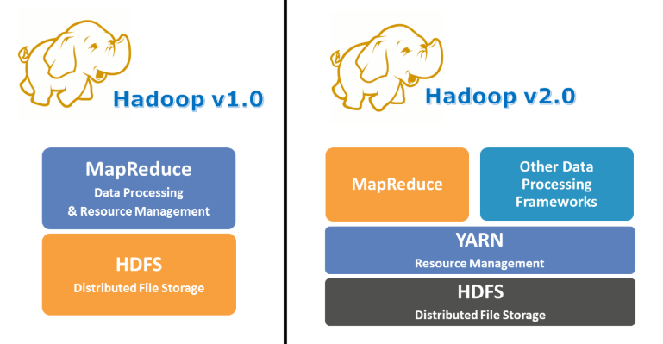
Why YARN?
Need for YARN
In Hadoop 2.0 fundamental change to Hadoop architecture was made.
The map reduce framework
Map Reduce-defines what operation to perform on data
Yarn-defines how those operations are to be scheduled and run on the clusters.
Source:https://www.edureka.com

Slide 5
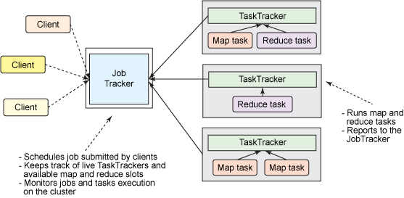
Why YARN?
Hadoop 1.0 Job Management

Slide 6
Why YARN?
Issues with Hadoop 1.0
Scalability
Efficient utilization of resources
Hadoop isn’t restricted to Map reduce paradigm

Slide 7
Why YARN?
Issues with Hadoop 1.0
Limits scalability
Job tracker runs on a single machine and is responsible for cluster management, scheduling and monitoring
Availability
JobTracker is the single point of availability/failure
Resource utilization problems
Predefined #map/reduce slots. Utilization issues because map slots may be full but reduce slots are free.
Limitation in running MR applications
Tightly integrated with Hadoop. Only MR apps can run. Can’t coexist with other applications.

Slide 8
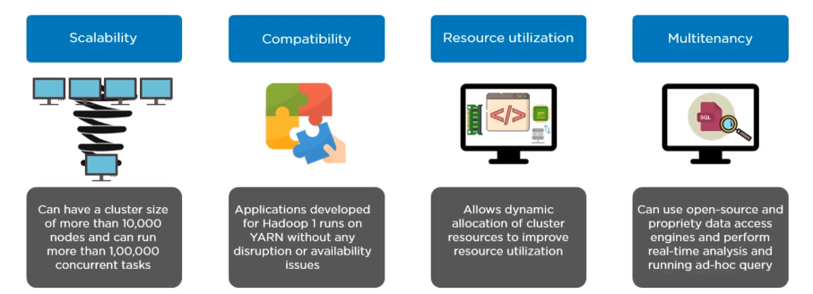
Why YARN?
With YARN

Slide 9
Yet Another Resource Negotiator
What is YARN?
YARN
YARN stands for “Yet Another Resource Negotiator” added recently in Hadoop in the year 2013.
Relieve
Relieve MapReduce by taking over the responsibility of Resource Management and Job Scheduling
Non-Map Reduce
YARN started to give Hadoop the ability to run non-MapReduce jobs within the Hadoop framework.

Slide 10
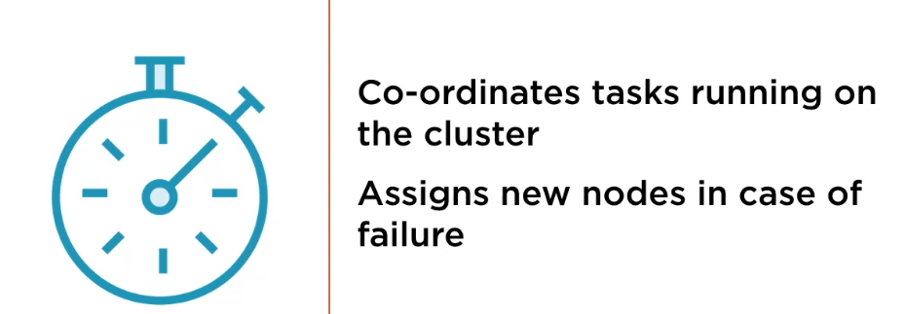
Yet Another Resource Negotiator
Typical operations that YARN can perform

Slide 11
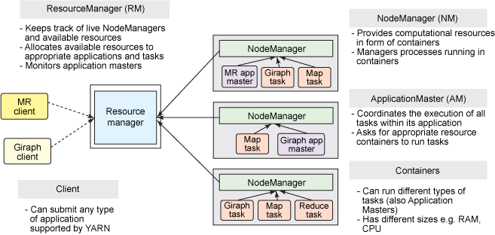
Yet Another Resource Negotiator
Architecture

Slide 12
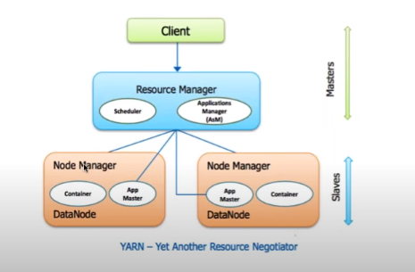
Yet Another Resource Negotiator
Yarn Components

Slide 13
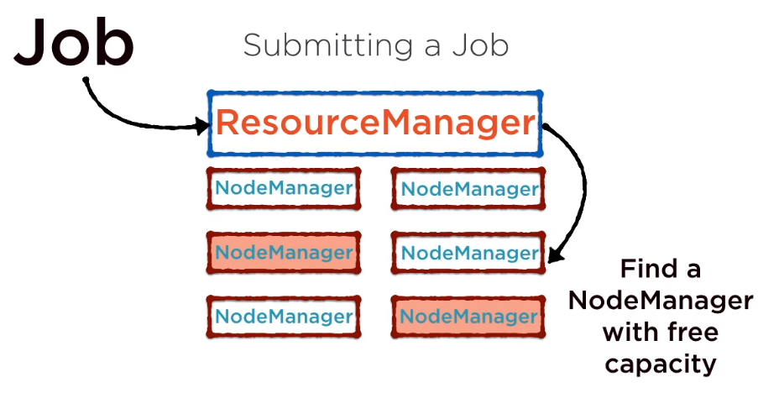
Yet Another Resource Negotiator
Yarn Components

Slide 14
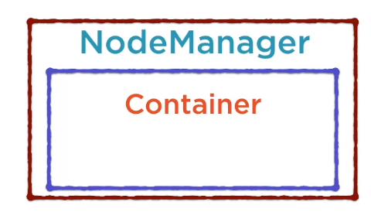
Yet Another Resource Negotiator
Yarn Components
Logical unit for resources the process needs CPU, Memory, disk etc.
All processes run within a container
Container executes that specific application
More than 1 containers in one node manager

Slide 15
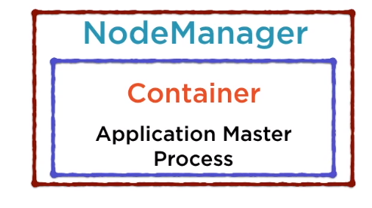
Yet Another Resource Negotiator
Yarn Components
AMP performs the computation required for the task
Any additional resources is required, AMP makes the request

Slide 16
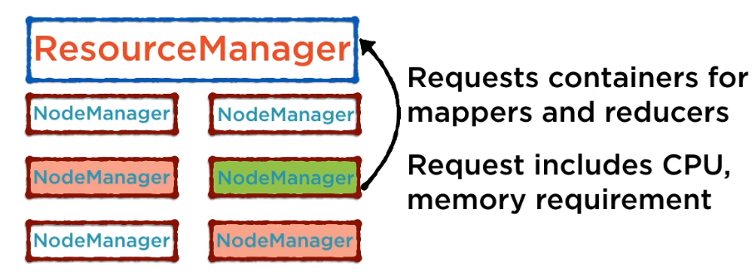
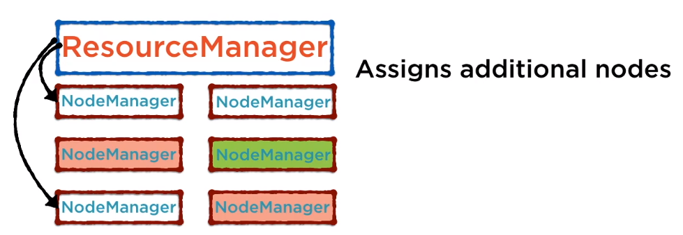
Yet Another Resource Negotiator
Yarn Components

Slide 17
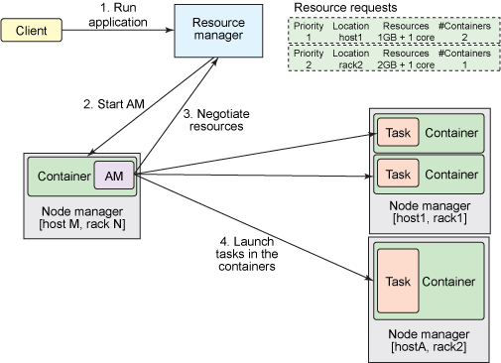
Yet Another Resource Negotiator
Working Flow of YARN

Slide 18
Yet Another Resource Negotiator
Data Locality in Map Reduce
Attempts to run the map task on a node where the input data resides in HDFS.
data locality optimization - it doesn’t use valuable cluster bandwidth.
What happens when all nodes hosting the block replicas are busy?
look for a free map slot on a node in the same rack as one of the blocks.
Very occasionally even this is not possible, so an off-rack node is used, which results in an inter-rack network transfer.

Slide 19
THANK YOU
“WORLD IS ONE BIG DATA PROBLEM”
“TORTURE THE DATA AND IT WILL CONFESS TO ANYTHING”

